Slide 1




Minnesota Transformation Initiative
Leadership and Management Training
Module 8: Creating Systems for Quality Improvement
Notes:
Hi, I'll be leading you through module 6 in the this leadership and management course: Creating Systems for quality improvement.

Slide 2


Learning objectives
Describe why systems for quality improvement are important for organizations
Describe how data can be used to improve outcomes
Identify what types of data YOU should consider tracking and how you might use it
Notes:
The learning objectives for this particular module. First you should be able to describe how managers can use clear and consistent goals as a way to move organizations forward, next you should be able to describe how data can help motivate direct support staff and measure success in service delivery, and finally you should be able to identify what types of data YOU should consider tracking and how you might use it?
Identify what types of data YOU should consider

Slide 3

Leadership is about connecting the dots....
Best practices
Mission, vision and values
Allocation of resources
Person-centered, individualized job placement & community engagement
Notes:
We’ve mentioned throughout this course that a lot of leadership comes down to connecting the dots. The modules in this course focus on themes you should be paying attention to as a manager, supervisor, leader and hopefully you’ve noticed just how much each of these themes or focus areas really do intersect and overlap with one another. And we’ll certainly see this as we talk about this idea of creating systems for quality improvement. We’ve talk already about best practices, mission, vision and values, paying attention to how we allocate and/or reallocated. See if you can begin connecting dots in your current role?

Slide 4

Reminder: Clear and Consistent Goals
An explicit commitment to increasing competitive, integrated employment
Driven by specific, measurable goals that reflect mission
Notes:
Simply stated, having clear organizational goals help us to quickly communicate what's important to our organizations, and to the people we support. And equally important, goals help us motivate the people who are part of making those goals happen. Those goals communicate intent, they get people excited, they give people a direction to go in.
We’ve talked multiple times in this course about the importance of organizations having clear and consistent goals as a way of moving an organization forward, in fact, it was one of the 10 essential elements of organizational transformation that was talked about in one of our previous modules about transformation. And while there are many goals your organization may have, because we are focused on employment outcomes in this course, we come back again to the idea that if you really want to move the needle on employment outcomes, it’s critical to have an explicit commitment to increasing competitive integrated employment that we frame in terms of specific, measurable goals that are tracked, analyzed and shared. There are certainly OTHER types of goals organizations have…but for the scope of this course, that’s where we’re focusing our attention today.

Slide 5

Quality: a measure of excellence
Notes:
Let’s shift and define what we mean when we use the word quality:. In short, quality is a measure of excellence. The problem is that what constitutes quality could be very subjective…meaning, if you ask many people what it means to provide quality services in your business you may get different answers, so it’s important for this discussion to constantly be defining what quality could or should look like. And we’ll break that down here.

Slide 6
Quality Assurance and Quality Improvement
Quality Assurance: process ensuring everything meets particular industry rules and/or standards
Quality Improvement: a framework to improve or make outcomes better over time
Notes:
Let’s define what we mean when we’re talking about the terms quality assurance and quality improvement. I’m sure you’ve heard these terms before and as a middle manager they are important things for you to be thinking about. First quality assurance is all about having processes in place to ensure that your organization is meeting particular industry rules or standards. We talked in previous modules about some of the industry rules and standards related to employment services and how those have continued to evolve overtime into what we call best practices.
Quality improvement is slightly different in that it is a framework that is focused on improvement or making outcomes better overtime. And that’s really what we want to focus on..this idea of having a framework in place for continual quality improvement.

Slide 7
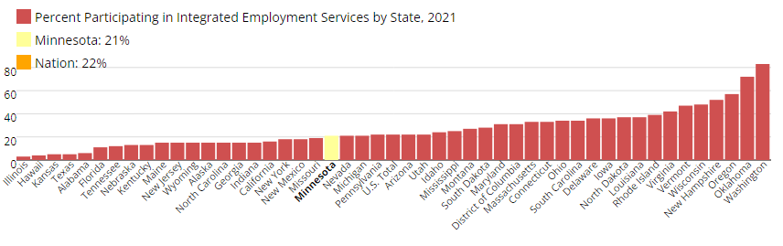

National Data: www.StateData.info
Notes:
Let’s take a minute to look at some data to give you a sense of how we are doing nationally related to employment for people with disabilities. This data comes from a site called Statedata.info which houses a longitudinal or long term data project that is led by ICI umass boston and is funded by the administration for community living. This is important data because it allows us to measure national progress over a long period of time. What we see here is 2021 data that shows the percentage of people participating in integrated employment services in each state. You can see that the national average is 22%, with Minnesota …the yellow rectangle along the bottom of the chart, coming in at 21%...a little lower than the national average. There are many different points of data, but this just gives you a sense of where MN fits within he national framework. Most states, including MN have goals to increase the number ofpeople with disabilities that are working, so knowing what the data says is always a good place to start when thinking about goals and quality.

Slide 8
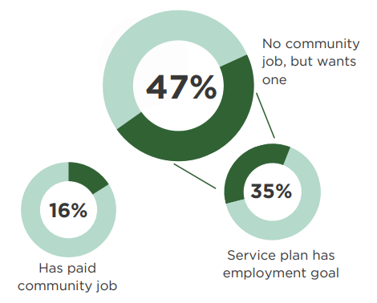
National Data: National Core Indicators (NCI)
Many people that want jobs:
don’t have them, and
for many people, it isn’t ending up in their plan.
2021-22 DATA AT A GLANCE (nationalcoreindicators.org)
Notes:
This particular data comes from survey information gathered by National Core Indicators or NCI, if you haven’t taken a look at the information gathered by NCI it is worth a look and you can find lots of data at national core indicators. Org. This particular data shows us that out of the adults with disabilities that were surveyed, that only 16% of people had a paid job at the time of the survey. And of course we know that this is extremely low when we look at percentages of people without disabilities working, those numbers are much, much higher. Now, out of the people surveyed that do not have jobs, almost halfof those people say they want a job and out of those people that want a job, only 35% of them have that goal in their service plan. This is a really important piece of data to pay attention to because it tells us that what people want may not be making it into their plans and if it isn’t in their plans, it often does not get focus or resources.

Slide 9

What are your priorities?
Notes:
And what we’ll keep coming back to the idea of being clear about what your priorities are as an organization are? Priorities may change over time, but it’s important to know what they are today

Slide 10
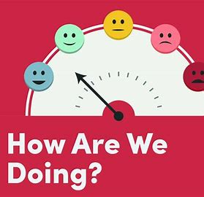
People told us their priorities were getting married, having their own home, and getting a job.
We had to ask our 250 staff how many people are wholly focused on helping people:
Develop significant relationships
Find a job
Become homeowners
Peggy Terhune, Arc of Stanley County
Notes:
As an example, a colleague of ICI umass boston is Peggy Terhune who is a leader at the Arc of Stanely County in NOC. And she talked about their process of transformation, during which They asked people they support what their priorities were and they were told that the things they wanted most were to get married, have their own home and to get a job. They then asked their 250 staff : how many of you are wholly focused on helping people, one, develop a significant relationship, two find a job, and three, become home owners. Peggy's message here was that that we've got to align your work, and that means spending most of your time and your staff’s time on the things that achieve the goals that we're aiming towards, and not getting distracted by other things that won’t get you there. That was the exact message that came out of last month’s module about properly aligning resources.

Slide 11
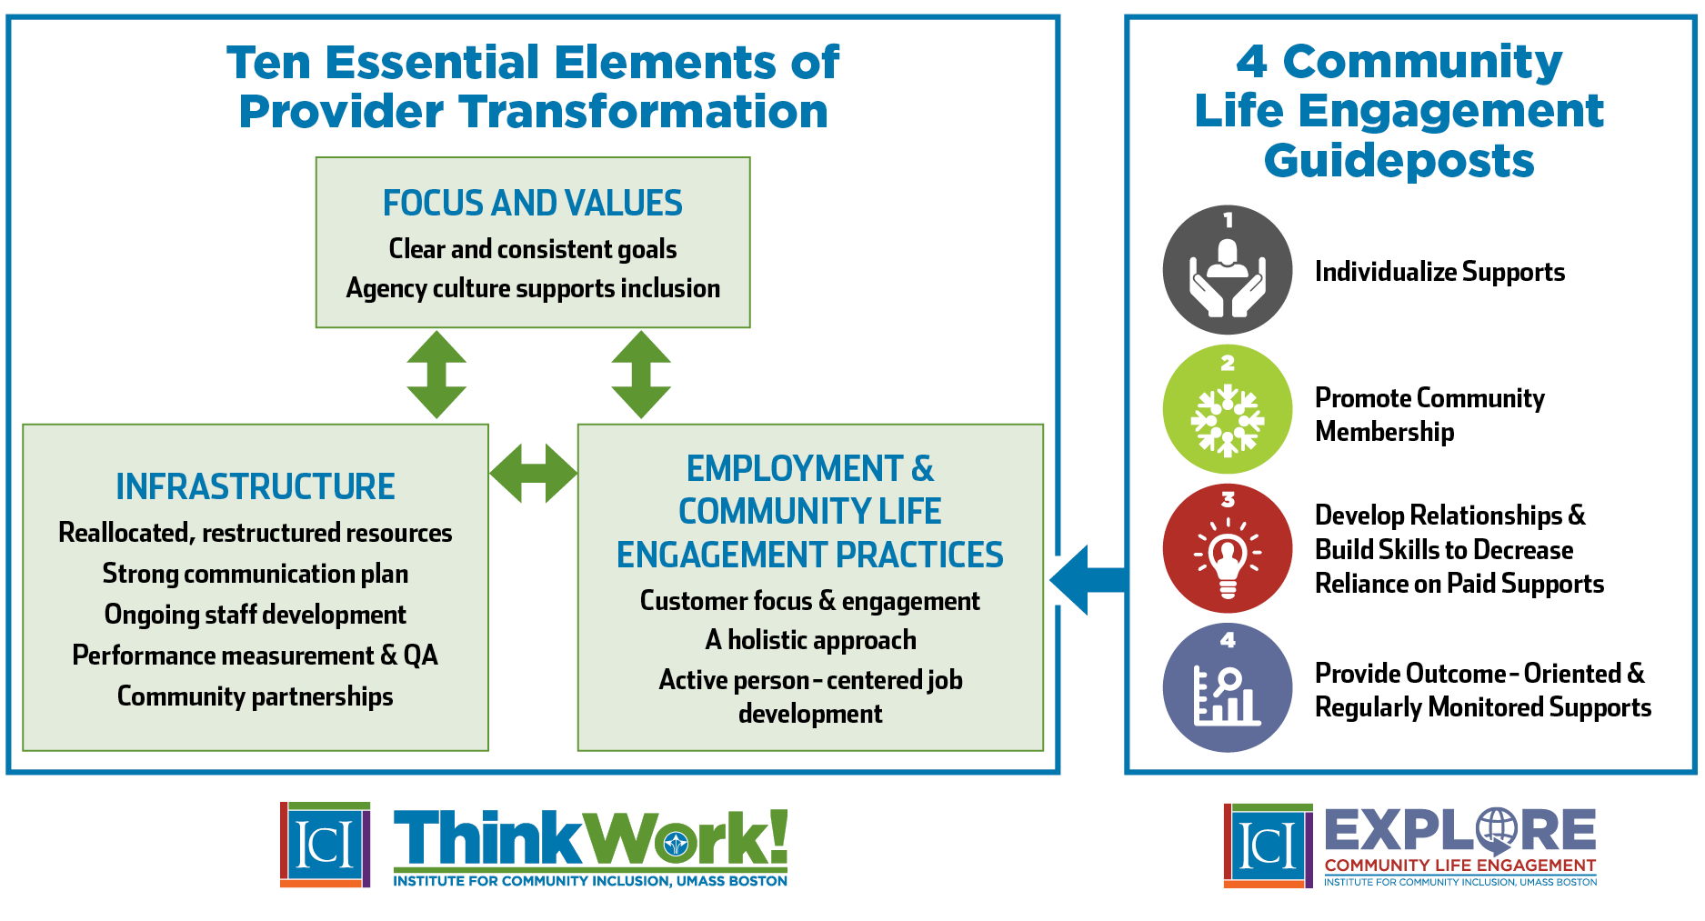
Notes:
And here I just want to quickly highlight the visual of the 10 essential elements or provider transformation as a reminder that all of these elements are so intertwined and must work together. In the infrastructure/operations and finance bucket we have highlighted performance measurement and quality assurance. As a middle manager or supervisor, you should be aware of what kind of performance measures your organization uses and how they are tracked.

Slide 12
What are your priorities?
Employment
Community engagement
Skills
Relationships
Natural supports
Increased independence
  Transportation
  Communication
Customer satisfaction
What else?
Notes:
So, let’s stop a minute to identify what the priority areas may be for your organization? I’m going to make some guesses that in general your organization’s priorities include things like increased employment outcomes, increased community engagement outcomes, increased skill development, increased development of relationships and natural supports, perhaps supporting people to have increased levels of independence around things like transportation or communication, etc. , mahy organizations have goals related to customer satisfaction. But, can you identify other priority areas your organization has identified? If you don’t know this information about your organization, then your homework is going to be to ask your supervisor, or someone in your organization that does know. But, remember that if we really want to create that framework for quality improvement we’ll want to look a little deeper

Slide 13
Employment quality outcome data examples
Number of competitive and integrated employment outcomes
Hours worked
Wages
Access to benefits & promotion
New skills learned
Natural supports
Job retention
Variety of industries
Others?
Quality
Notes:
So let’s take a closer look at JUST employment as an example…while organizations certainly should be tracking numbers of people working, there may be other indicators of quality that your organization will want to pay attention to. For instance, is it just employment outcomes in general that you’re tracking or are you tracking specifically competitive and integrated employment outcomes as the gold standard. We’ve talked in multiple modules the historical importance of being clear about what kind of employment we’re talking about because people with disabilities have not had equal access. But, beyond that…there are other indicators that you also many want to consider as indicators of quality. And keep in mind that these indicators should be measurable, otherwise, you won’t have any real way to track them consistently. Examples include things like number of hours people are working in a 2 week period, hourly wages received, does the person have access to benefits and promotions, how many new skills has the person learned over time on the job, have natural supports been developed, how long are people retaining their jobs, Perhaps your organization tracks of the VARIETY or types of industries in which people you support are working….thse are all examples of potential indicators of quality that may be useful to track overtime. And if each of these are data points that are being tracked, with organizational goals associated with them, then you’re on your way to creating a plan associated with quality improvement. A simple example is that perhaps you currently are seeing an increase in numbers of people that are competitively employed, but when you look more deeply at the retention data, you see that there are a lot of people GETTING jobs, but many of those people LOSE their jobs within the first 2 months. This data MIGHT be telling you that you need to look at your individual job placement strategies to determine whether there is a problem with appropriate job matches. Maybe this points to the need to look more closely at Discovery and job negotiations. But, without data points to look at, it’s going to be difficult to figure out the realy picture of what’ happening

Slide 14
Community engagement quality outcome data examples
Relationships and/or natural supports developed
Skills learned
Volunteerism
Participation in integrated community groups
Increased independence
Others?
Notes:
And let’s look at one more example, but instead of employment, let’s consider community engagement quality outcome data examples. You may want to track of numbers of unpaid relationships or natural supports that are developed through a person’s community engagement, you may want to track skills learned or volunteerism opportunities or participation in integrated community groups, perhaps you want to track if or how a person’s independence has increased in some way (for instance, the person was able to learn to ride public transportation with our without support). This is all to highlight the fact that if you aren’t clear on what your goals are, how do you know if you are meeting your quality standards…and by the same token, how will you know what or where you may need to focus your attention as a manager

Slide 15

John F. Kennedy
BHAG for 1960s America:
Put a Man on the Moon & Return Him Safely
BHAG
Notes:
An effective goal is not only specific and measurable, but it’s challenging. We talked in a previous module about the term that Jim Collins’ coined called BHAG, or big hairy audacious goals, and an example that gets talked about a lot is the goal that was established by president kennedy. In 1961 he said : we’re going to put a man on the moon and return him safely before the end of this decade. It was a challenging task and it was a stretch. But, it was also something that was possible. Something like a BHAG moves us forward.
The take away here is that If we set our goal to increase competitive integrated employment outcomes in our organization by 1% a year, well, we figure we could just try a little harder than we did last year. BUT…a big, hairy audacious goal FORCES us to do things differently and creates a different kind of pace of change. And a system for quality improvement can help identify and manage those goals.

Slide 16

What’s Your BHAG?
“We’re going to get 60 jobs in 2006”
Notes:
I’m going to share a story about an organization that ICI worked with in the mid- 2000s called the Coastal center, located in savannah, Georgia. At that time, the Coastal center was a medium-sized organization that supported about 250 people, mostly in a sheltered workshop, some in a day habilitation program, and a handful of people working out in community jobs. ICI spent a couple of days with them, and at the end of the two days, the executive director stood up in front of the staff and said, we’re going to do this and we’re going to get 60 jobs in 2006. People stopped in their tracks. They weren’t sure that it was possible. But, the organization stepped up and it forced them to make significant changes. They restructured staffing, they changed staff roles to focus on employment, they moved case managers to be employment staff. They took staff that had been working in the workshop, and reassigned them to employment. At the end of the year, the coastal center had almost accomplished the original goal and 57 people had gotten individual community jobs. They were good jobs and they were personalized. They had taken the time to listen to people, they got to know what people wanted, and they moved themselves substantially forward in a very short period of time. That’s a powerful goal. It was specific, it was challenging, but achievable. The goal was easy to share and explain and they talked about it as an organizational all the time with all of their stakeholders, people they supported, families and the larger community.

Slide 17


Also consider process or team goals
# people with an employment goal in their plan
# employer contacts
# hours spent on activities of job development
# of days spent in CE process (from Discovery to placement)
# staff trained and mentored to do CE
Notes:
We often think about those large outcome goal as driving change within your organization, but you may also want to consider things like process or team goals. These speak to the strategies or processes you’re using to hopefully reach those larget outcomes, like number of people working. There are a few examples here on your screen, and I’ll be asking you to reflect on this in reference to your own organization after this module ends. Examples include the number of people with an employment goal in their service plan, because remember the data we looked at at the beginning of this module that tells us many people that want to work don’t have this properly reflected in their plan, other things to track could be number of employer contacts that your team makes over the course of a week or a month. It might be staff time spent on job development every week….specifically time spent in the field talking with employers (not in the office doing paperwork) or the length of time it takes to get a job, in this case the number of days from the start of discovery to job placement. And number of staff trained and mentored support the customized employment process

Slide 18
Quality Improvement: Taking stock
Define your key outcome measures
What are the identified goals for your organization and YOUR department?
Define your key process measures
What data is collected?
How is it used?
How is that data shared?
How do you talk to your team about data?
Notes:
So let’s pause here so that you can begin to take stock and bring this back to your work at your organization. Are you able to identify the key outcome measures that your organization has identified? Do you know where to find these? Do you know how and where they are communicated? The 2nd part of taking stock is identifying what data is currently being tracked to measure progress. Who tracks the data, how frequently, where is it kept, how is the data used, how is it shared and how do YOU talk to your particular team about data? Now, if you don’t know the answer to these questions, then a place to start may be to check in with your supervisor or agency leadership to find out. It’s really important for organizations to be very transparent about this information…in other words…it shouldn’t be a secret. All stakeholders associated with the organization should have some understanding of what the goals of the organization are. If not, then it’s really very difficult to know how resources should be used, what staff should be spending their time on and ultimately, without this information, how are you tracking success.

Slide 19
Quality Cycle: Plan, Do, Check, Act
Track outcomes
Share data with stakeholders
Correct course as needed
Celebrate successes
Identify desired outcomes
Implement
What gets measured, gets done!
Notes:
At the most basic level, what we are talking about here is called the quality cycle: sometimes described as Plan, Do, Check, Act. Essentially, it means an organization, a department or even a small team, should very clearly be identifying what are the desired goals and outcomes you are setting out to achieve. Based on those outcomes, you're going to be implementing the strategies, procedures, policies, that you believe will lead to the identified outcomes. You're going to track the outcomes to see if you are getting the results you wanted, you should be sharing the data with appropriate stakeholders…both internal and external…. in order to be transparent, and based on what the data tells you there may need to be some course correction, or some intervention, or if you met your desired outcomes....you want to celebrate and share those successes with others...and of course, this cycle never stops. It's a continual cycle that constantly repeats….
This type of quality framework is critical to the success of your organization, in that if you aren't measuring the right things, how are you actually measuring how successful you are? And remember, what gets measured, gets done! But also a word of caution: you really only want to be collecting data that you will actually look at and use. You don’t want to waste staff time tracking something that is not important or won’t be looked at.

Slide 20

Quality Improvement and Staff Buy-In
Notes:
Again, part of YOUR job as a middle manager is to help your staff to understand the goals of the organization, the steps that need to be taken to reach those goals and about the data you will need to collect to support those goals. It’s CRITICAL that staff have an understanding of how and why data may be needed. They will need to see how the data is being used and what specifically you need from them to ensure you’re getting the right information. If you aren’t having these conversations within your organization, then it can become somewhat confusing about what may be expected.

Slide 21

Data: a tool for Middle Managers
Notes:
The bottom line here is that the data and metrics that get tracked by your organization are one of the most important TOOLS you have access to as a middle manager.
They help you focus your team on what you want to be accomplished, it providers timely or periodic feedback on how close you are to meeting your goals, it can provide a framework to analyze and correct course if you aren’t quite meeting your goals and it allows you to really dig deeper into identifying things like what teams are having what outcomes, or maybe even which staff are having what outcomes. And it isn’t necessarily about calling out individual staff, but again it’s about giving YOU the tools you need to know where to start in identifying potential action steps. When you sit down in your regular supervision or team huddles with your staff, what data are you reviewing and what actions need to come from that data to move you closer to those goals.

Slide 22

“Without data, you’re just another person with an opinion.”
~ W. Edwards Deming
Notes:
As we finish this module, I’d like to share a quick quote from management guru W. Edwards Deming who said “without data, you’re just another person with an opinion” This highlights the importance of moving beyond subjective opinions to instead having a more data-driven approach to management within your organization and quality management in general. Now that you’ve completed this video, take time to complete the assignment in the learning platorm associationed with Quality Improvement.

